Slide 1
SOFTWARE CONFIGURATION MANAGEMENT FOR PROJECT LEADERS
TIM KASSE AND PATRICIA A. MCQUAID
Kasse Initatives, LLC, and
California Polytechnic State University

Slide 2
Software Configuration Management:
Software configuration management is the task of tracking and controlling changes in the software.
CM practices include revision control and the establishment of baselines.
If something goes wrong, SCM can determine what was changed and who changed it.

Slide 3
Purpose of SCM:
To establish and maintain the integrity of the products produced throughout the project’s software life cycle.
SCM plays a role of a support function that helps a project leader for better management and control of the project (IEEE 1997).

Slide 4
Need of SCM:
Prime contractors are integrating millions of lines of code from multiple subcontractors.
Companies are required to produce and maintain variants of their main product.
So, ‘change’ is a fact of life in software development.

Slide 5
Need of SCM:
Software quality assurance and SCM are not perceived as value-added by project leaders and software developers.
SCM is frequently viewed by developers as a hindrance to product improvements.
Overhead associated with the change control function of SCM.

Slide 6
Problems caused by poor SCM:
The latest version of source code cannot be found.
A difficult defect that was fixed at great expense suddenly reappears.
A developed and tested feature is mysteriously missing.
A fully tested program suddenly does not work.

Slide 7
Problems caused by poor SCM:
There is no traceability between the software requirements, documentation, and code.
Programmers are working on the wrong version of the code.
The wrong versions of the configuration items are being baselined.
No one knows which modules comprise the software system delivered to the customer.

Slide 8
Problems for Project Leaders:
Projects to meet difficult deadlines found scarce time resource constantly under attack because of the rework caused by these reasons.
Project leaders cannot afford redoing what was already done.
The cost of rework adds greatly to the cost of developing software.

Slide 9
Solution – Raytheon Electronics- An example
In 1988 Raytheon Electronic Systems began using a cost of software quality model derived from Philip Crosby (1984) and process improvement methods.
By 1991, Raytheon moved from CMM level 1 to level 3.
By 1994 it decreased rework costs from 41 percent to 20 percent of project costs.
In 1995 it reached level 4.
Between 1988 and 1994, Raytheon’s cost of rework reduced to less than 10 percent of development cost.
Productivity of the development staff increased by a factor of 170 percent.

Slide 10
Gunter Air Force Base- An Example
Base supplies MIS software support for the entire Air Force.
500 outstanding Trouble Reports.
For every four defects one detects and “fixes” a new defect is introduced.
One product release per month.

Slide 11
Gunter Air Force Base- Changes
Number of trouble reports went from 500 to 50
Product releases went from once per month to once every six months.

Slide 12
Key Role of SCM:
SCM answers 4 Ws
Who- Who made the changes?
What- What changes were made to the software?
When- When were the changes made?
Why- Why were the changes made?

Slide 13
Components of SCM Configuration Identification:
Identifying of the structure of the software system
Identifying the related life-cycle work products
Provides a unique identifier for each work product
Supports traceability between the requirements and all other related software products.

Slide 14
Structures concerned with SCM
Problem-solving structure
System concept evolves through the life cycle by successive refinement and elaboration of the resulting work products
Product system structure
The system is composed of subsystem components, which are themselves composed of subsystem components.

Slide 15
Baselining:
Various changes in Software development.
Modification are necessary.
Fundamental success of any development effort depends on well-defined reference point.
The term baseline is normally used to denote such a reference point.

Slide 16
Baseline:
A baseline is an approved snapshot of the system at appropriate points in the SDLC.
Establishes a formal base for defining subsequent change
A baseline could be
A specification
A formally reviewed product
A partial system

Slide 17
Impacts of Baselining:
Once a baseline is established, change can be made but a specific, formal procedure must be applied to evaluate and verify each change

Slide 18
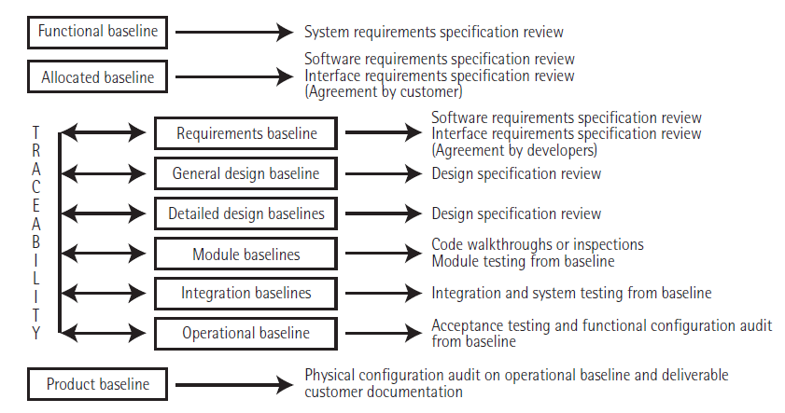
Baselining:

Slide 19
ThankYou
Any Questions?

